Slide 1

Intelligent traffic light using video based A.I. technology
Chan Tsz Kin
EG114402/2A
180177920

Slide 2
Introduce
Nowadays in Hong Kong, traffic signal system are programmed based on historical traffic data.
It is unable to adjust signal timing dynamically for handling unusual event such as Jaywalking occurring or vehicle over speeding.

Slide 3
Project Objective
Using this system…
To improve road traffic safety.
To regulate traffic signal according to real-time changes in different traffic conditions.

Slide 4
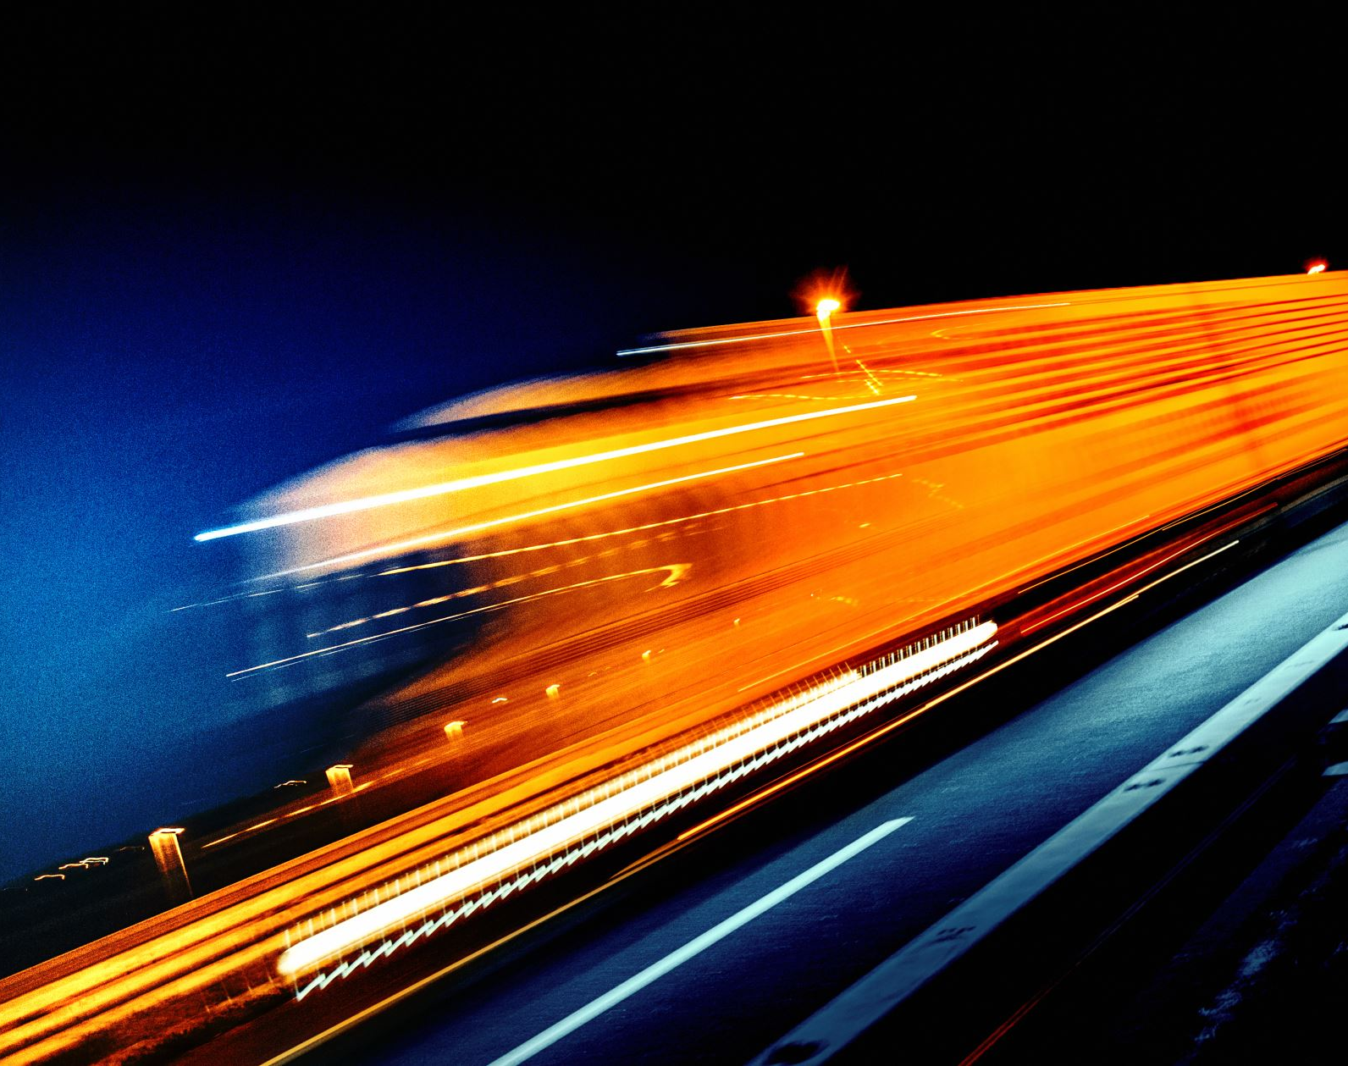
System Features
Object detection (vehicles and people)
Detecting jaywalker
Vehicle Counting
Estimating vehicles distance / speed
Regulating traffic signal based on traffic conditions
Warning road user when possible danger is found.

Slide 5
System design (components)
Hardware: IP Cameras and CPU
Software: An object detector and a tracker

Slide 6

System design (User Interface)

Slide 7
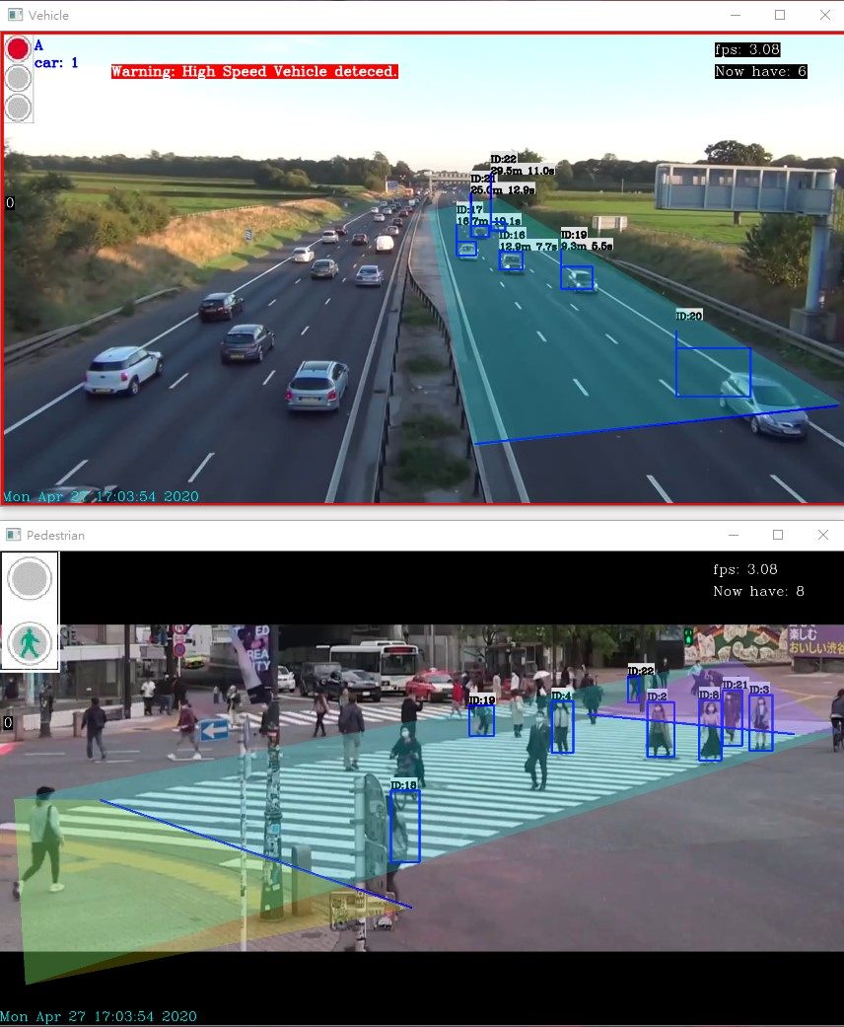
This is a counting line
These colored region are range of interest(ROI).
We set ROI to tell system which area is we want to focus on.
The UI consists of two windows – one is for vehicle and the other one for people

Slide 8
Each object have its own id no.
Here is a vehicle counter.
After a vehicle crossed the counting line, It will record.
If object class is vehicle, UI will show its remining time and distance to the counting line
Here shows the current FPS.
Also show the amount of detected objects on the screen.

Slide 9
If the system detects potential danger, It will send warning to all road users such as playing warning message though speaker.
This is a traffic light signal system simulation.
The number below the signal is a timer shows the remining time to change the traffic signal

Slide 10
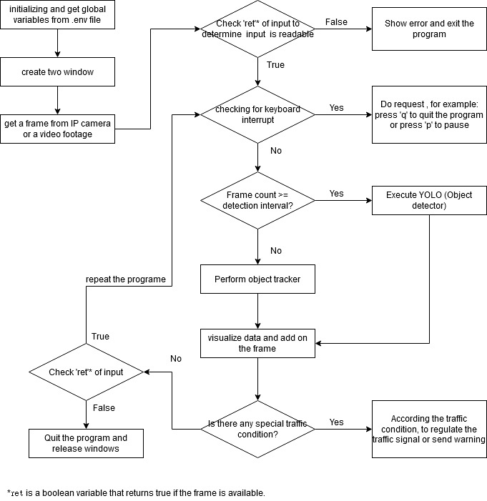
System workflow

Slide 11
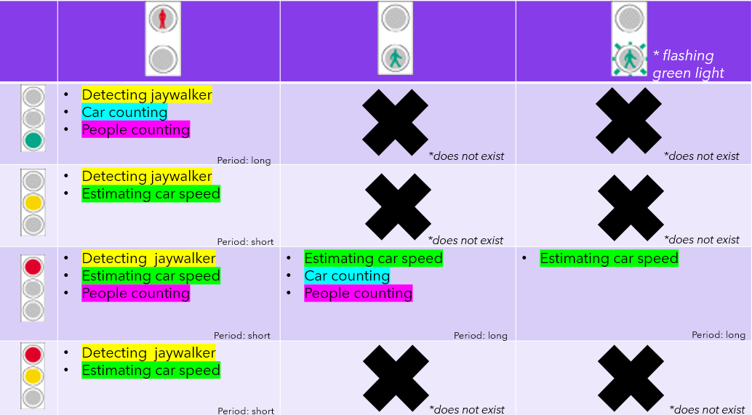
Working functions based on different traffic signals
When vehicle traffic light is not green, check that are vehicles slowing down or stay stationary

Slide 12
Working functions based on different traffic signals
When pedestrian traffic light is not green, check is there any jaywalker on the road

Slide 13
Working functions based on different traffic signals
Base on traffic condition, system will regulate the duration of traffic signal.
For example, now the vehicle traffic light is green and pedestrian one is red. There is no car on the road, and somebody are waiting for crossing road. The system will reduce the remining time of current traffic light signal.

Slide 14

What technology is involved?
Object detection – YOLO algorithm
Object tricking – OpenCV KCF algorithm

Slide 15
Object detection
Object Detection = Object Localization + Feature Extraction + Image Classification
Most of the object detection technologies are using Convolutional Neural Network (CNN) to do Feature Extraction and Image Classification

Slide 16
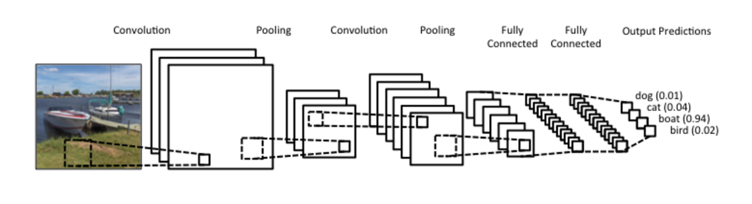
Convolutional Neural Network (CNN)
CNN consists of three parts:
Convolution Layer
Pooling Layer
Fully Connected Layer
Concept map:

Slide 17
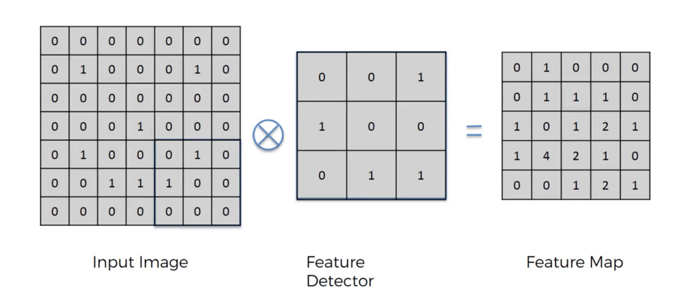
CNN - Convolution Layer
Convolution is the first layer to extract features from an input image.

Slide 18
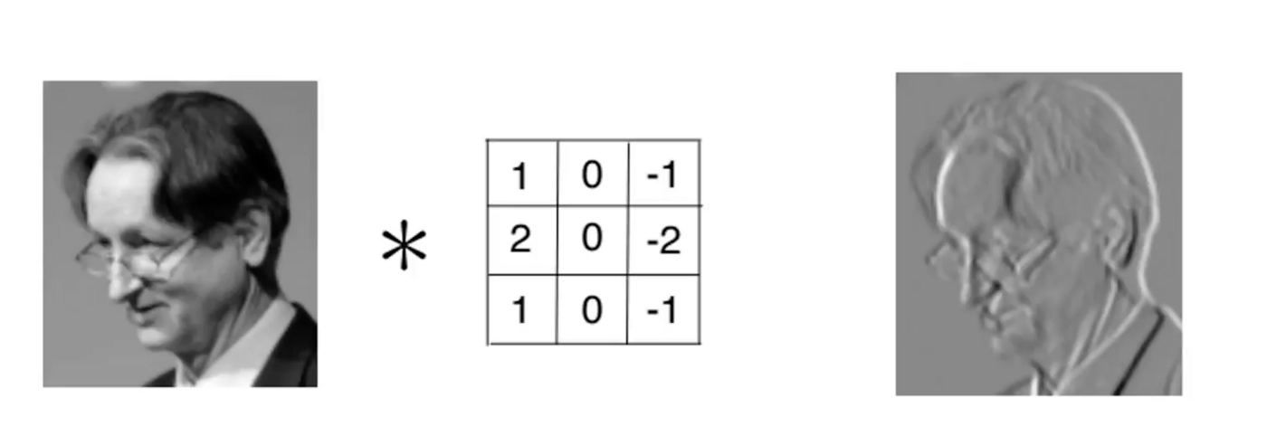
CNN - Convolution Layer
Visualized feature map
Example:

Slide 19
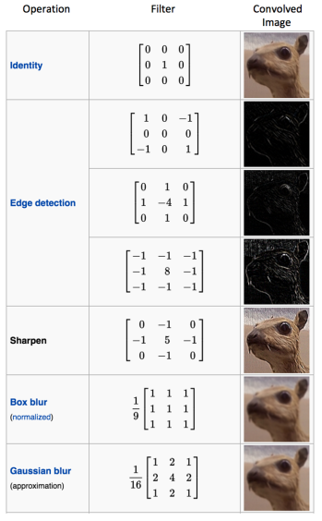
CNN - Convolution Layer
Convolution of an image with different filters can perform operations such as edge detection, blur and sharpen by applying filters.

Slide 20
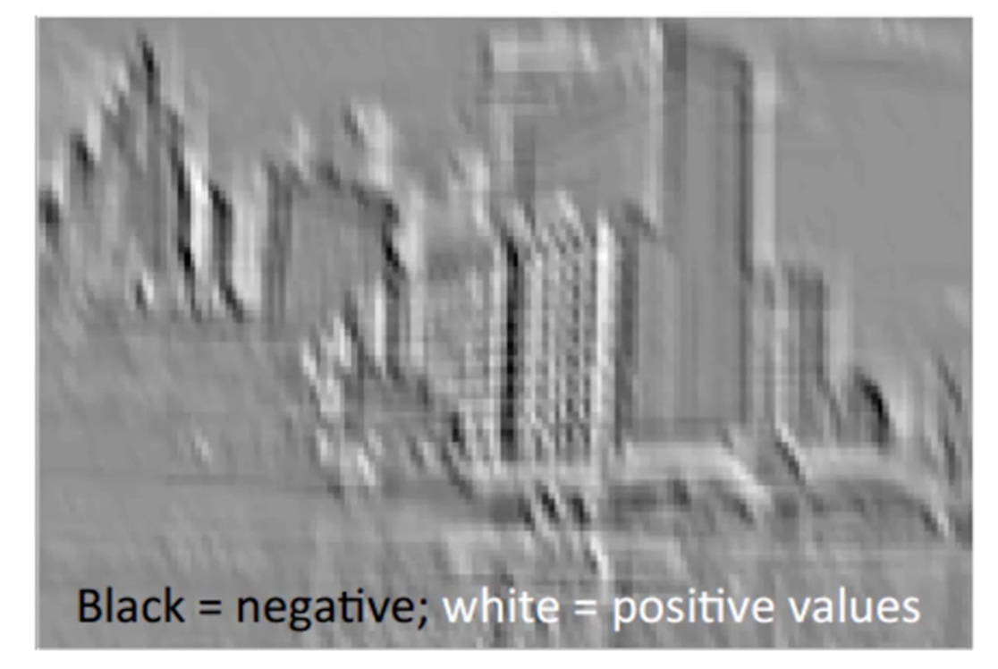
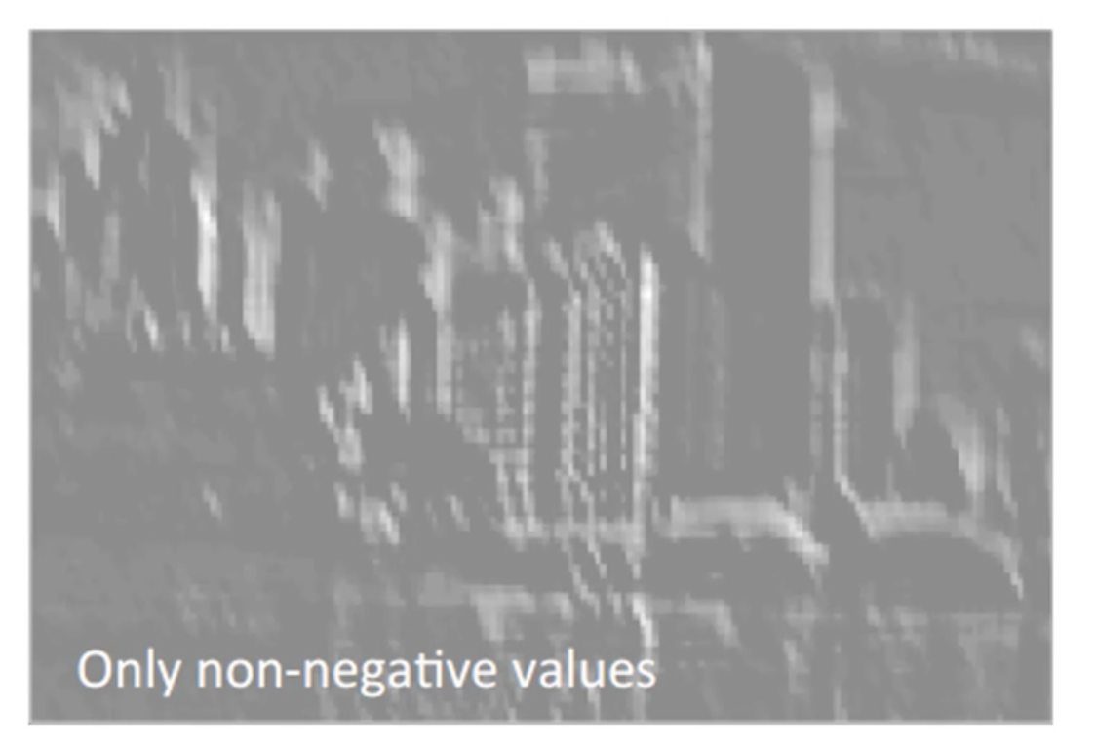
CNN - Convolution Layer
Other concepts:
Strides – make size of feature map smaller.
ReLU – make all data to non-negative values for CNN.

Slide 21
CNN – Pooling Layer
Pooling reduce the dimensionality of each map but retains important information (features).
Pooling also able to reduce noise.

Slide 22
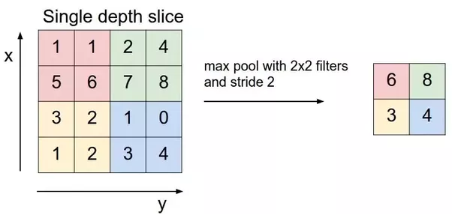
CNN – Pooling Layer
Max pooling example:

Slide 23
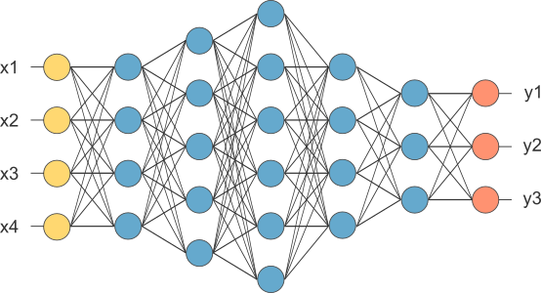
CNN - Fully Connected Layer
Fully connected layer flatten the matrix into vector and feed it into a fully connected layer like a neural network.
The outputs classify images.

Slide 24
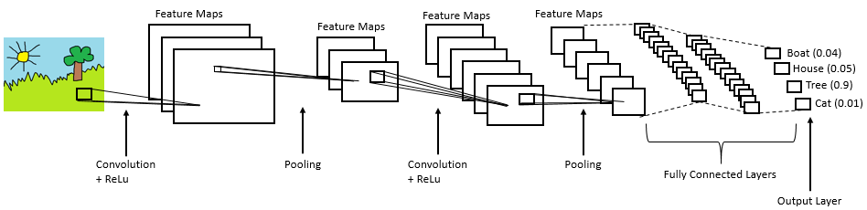
Convolutional Neural Network (CNN)
CNN performs feature extraction and image classification of object detection.
In next section, I will explain why I choose YOLO algorithm.

Slide 25
R-CNN
R-CNN is traditional model of object detection.
R-CNN will create around 2000 Region Proposals, then:
Use CNN to extract features from Region Proposal.
Use SVM to classify region is background or object.
Repeat each region proposals.
This is how R-CNN performs object localization .

Slide 26
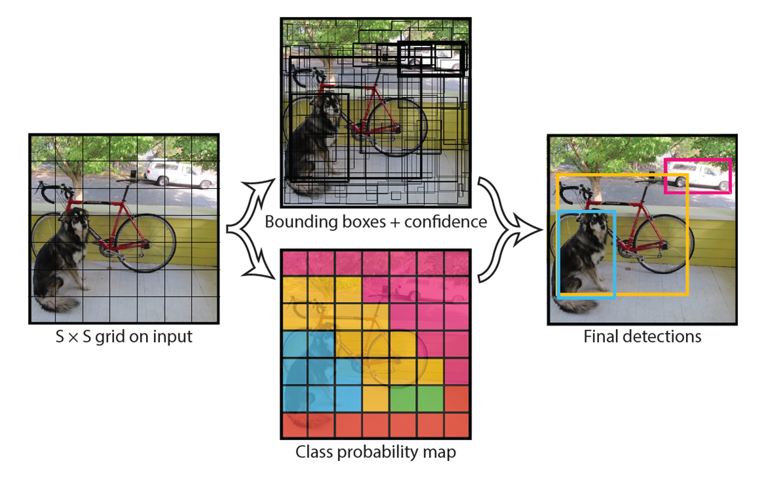
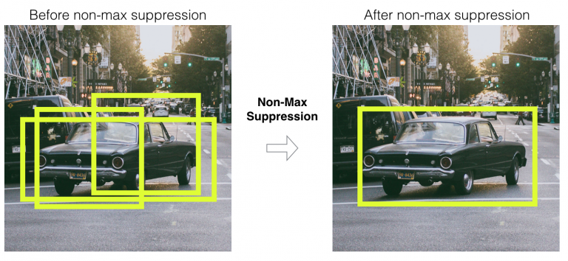
YOLO
Instead of creating region proposals, YOLO performs CNN to predict classes and bounding boxes for the whole image first.
It splits image to grid. Each grid cell handles predicting amount of bounding boxes and their confidence scores.
In addition, each grid cell have confidence scores for classifying object.
Finally, It performs non-max suppression to remove bounding boxes with low confidence score and bounding boxes with the highest shared area .

Slide 27
YOLO vs R-CNN
Since YOLO perform CNN once time in whole process, while R-CNN need to perform CNN for each region proposal, YOLO is much faster than R-CNN or its cousins.

Slide 28
Tracker
Trackers from OpenCV provides predicting the location of an object based on information such as object location or direction and speed of its motion from previous frame.

Slide 29
Tracker - benefits
Tracking is faster than Detection
Tracking can help when detection fails
Tracking preserves identity

Slide 30
Installation
Install anaconda 64 bit verson.
Create a new virtual environment in anaconda.
Open your CMD, then go to the project file directory. E.g. prompt "cd C:\Users\...\IBSP_Traffic".
Activate the new anaconda virtual environment. Prompt" activate <name of your virtual environment>"
Install the packages which are mentioned in _requirements.txt_, prompt "pip install -r requirements.txt".
Prompt "conda config --add channels conda-forge "
Prompt "conda install shapely“

Slide 31
First set-up
Open .env file, modify values based on your device and input paths.
Run program:
Prompt "cd (the project file directory)".
Activate the appropriate virtual enironment. Prompt" activate (name of your virtual enironment)"
Run "python -m main".

Slide 32
First set-up
Modify ROIs and count lines on both windows. You can do so by modify .env file directly or modify on GUI (recommend).

Slide 33
Program Demo

Slide 34
Future modification
GPU version
Using IP cam
Change the method of estimating vehicle speed and distance (Consider Perspective Transformation)
Train an own version model.

Slide 35
Conclusion
This system is a low-cost solution to improve safety of society.
Idea: Data collected by this system can send to backend for analyzing. If we equip this system on each traffic light in a region, can be combined into a smart traffic control system, which can deal with traffic congestion in a society .

Slide 36
Reference
https://appsilon.com/object-detection-yolo-algorithm/
https://medium.com/@RaghavPrabhu/understanding-of-convolutional-neural-network-cnn-deep-learning-99760835f148
https://cw.fel.cvut.cz/b172/courses/mpv/labs/4_tracking/4b_tracking_kcf
https://www.learnopencv.com/object-tracking-using-opencv-cpp-python/

